Slide 1

Macroeconomics of Monetary Policy, Fiscal Policy & Inflation
Swagat Kishore Mishra
LECTURE 25

Slide 2
Outline
Macroeconomics
Monetary Policy (Liquidity Preference)
Inflation
Demand-pull & Cost-push Inflation
Monetary Policy changes and Inflation

Slide 3
Economics
Microeconomics the study of how households and firms make decisions and how they interact in markets.
Macroeconomics the study of economy wide phenomena, including inflation, unemployment, and
economic growth.

Slide 4

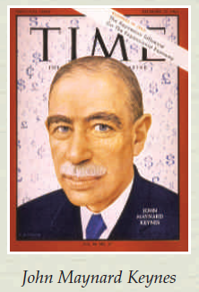
Macroeconomics
Keynes:
In 1936, economist John Maynard Keynes published a book titled The General Theory of Employment, Interest, and Money, which attempted to explain short-run economic fluctuations in general and the Great Depression in particular.
Keynes’s primary message was that recessions and depressions can occur because of inadequate aggregate demand for goods and services.

Slide 5
In the long run, inflation occurs if the quantity of money grows faster than potential GDP.
In the short run, many factors can start an inflation, and real GDP and the price level interact.
To study these interactions, we distinguish two sources of inflation:
Demand-pull inflation
Cost-push inflation

Slide 6
Monetary Policy
Many people think that inflation makes them poorer because it raises the cost of what they buy. This view is a fallacy, however, because inflation also raises nominal incomes.
Inflation is a sustained increase in the general price level leading to a fall in the purchasing power of money.
Economists use the term inflation to describe a situation in which the economy’s overall price level is rising.
The inflation rate is the percentage change in the price level from the previous period.

Slide 7
Shifts in aggregate supply can cause stagflation—a combination of recession (falling output) and inflation (rising prices).
Theory of liquidity preference: Keynes’s theory that the interest rate adjusts to bring money supply and money demand into balance.
The inflation rate depends primarily on growth in the money supply, which a nation’s central bank controls.

Slide 8
Demand Pull Inflation
Wage inflation is also called as demand-pull or excess demand inflation.
This type of inflation occurs when total demand for goods and services in an economy exceeds the supply of the same.
When the supply is less, the prices of these goods and services would rise, leading to a situation called as demand-pull inflation.

Slide 9
Symptoms: Demand pull inflation
Shown by outward shift of demand curve.
When demand grows faster than supply it pulls prices up.
If firms cannot meet the demand, they increase their prices.
Demand pull inflation is characterized by shortages, low levels of stocks, long waiting lists and queues.
10/25/2012
9

Slide 10
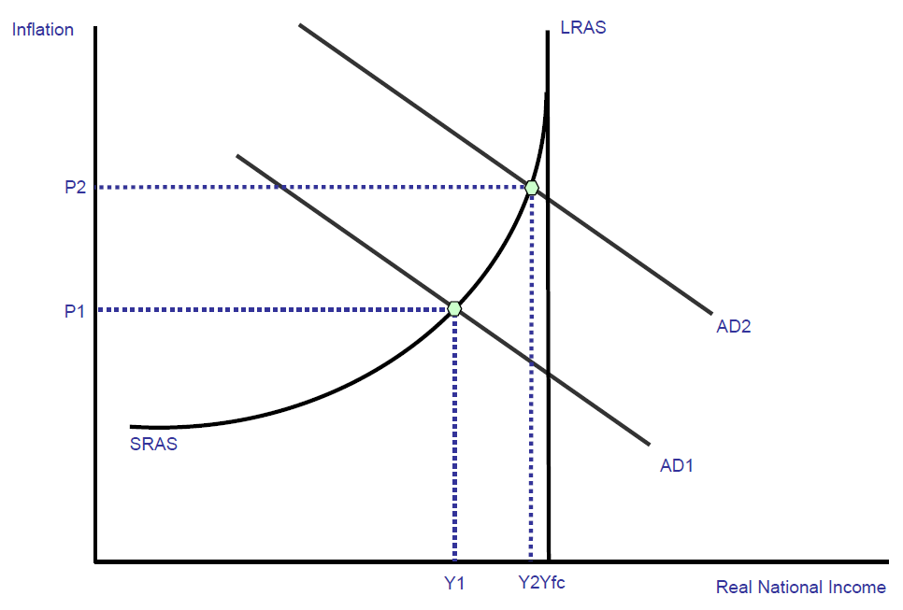
Demand pull inflation occurs when aggregate demand and output is growing at an unsustainable rate leading to increased pressure on scarce resources and a positive output gap.

Slide 11
A depreciation of the exchange rate which makes exports more competitive in overseas markets leading to an injection of fresh demand into the circular flow and a rise in national and demand for factor resources – there may also be a positive multiplier effect on the level of demand and output arising from the initial boost to export sales.
Higher demand from a government (fiscal) stimulus e.g. via a reduction in direct or indirect taxation or higher government spending and borrowing. If direct taxes are reduced, consumers will have more disposable income causing demand to rise. Higher government spending and increased borrowing feeds through directly into extra demand in the circular flow.
Monetary stimulus to the economy: A fall in interest rates may stimulate too much demand – for example in raising demand for loans or in causing rise in house price inflation.
Faster economic growth in other countries – providing a boost to UK exports overseas.
Improved business confidence which prompts firms to raise prices and achieve better profit margins

Slide 12
Cost Push Inflation
If there is increase in the cost of production of goods and services, there is likely to be an increase in the prices of finished goods and services. i.e. A rise in the wages of labourers would raise the unit costs of production and this would lead to rise in prices for the related end product.
This type of inflation may or may not occur in conjunction with demand-pull inflation.

Slide 13
Symptoms: Cost push inflation
Caused by costs increasing i.e. higher wages, greater raw material costs, higher import prices, monopolists raising their prices etc.
Faced with higher costs firms increase their prices to customers to maintain profit margins.
This shifts the aggregate supply curve to the left.
10/25/2012
13

Slide 14
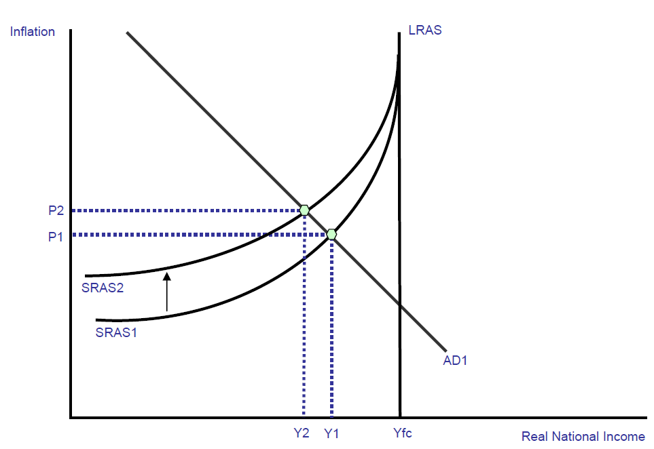
Cost-push inflation can be illustrated by an inward shift of the short run aggregate supply curve.

Slide 15
Component costs: e.g. an increase in the prices of raw materials and components. This might be because of a rise in global commodity prices such as oil, gas copper and agricultural products used in food processing – a good recent example is the surge in the world price of wheat.
Rising labour costs - caused by wage increases that exceed improvements in productivity. Wage and salary costs often rise when unemployment is low (creating labour shortages) and when people expect inflation so they bid for higher pay in order to protect their real incomes.
Higher indirect taxes imposed by the government – for example a rise in the duty on alcohol, cigarettes and petrol/diesel or a rise in the standard rate of Value Added Tax. Depending on the price elasticity of demand and supply, suppliers may pass on the burden of the tax onto consumers
A fall in the exchange rate – this can cause cost push inflation because it normally leads to an increase in the prices of imported products. For example during 2007-08 the pound fell heavily against the Euro leading to a jump in the prices of imported materials from Euro Zone countries.

Slide 16

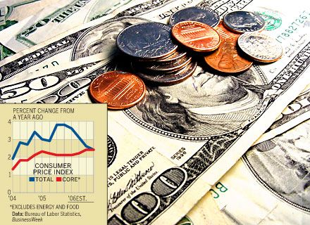
Lecture Progress until here…..
Defining Macroeconomics with reference to the contribution of a noted economist
Monetary Policy: Norms and Implications
Aggregate Demand and Aggregate Supply
Inflation: causes and types

Slide 17
Narrow, broad and high powered money
The total stock of money in circulation among the public at a particular point of time is called money supply.
RBI publishes figures for four alternative measures of money supply,
M1, M2, M3 and M4. They are defined as follows
M1 = CU + DD
M2 = M1 + Savings deposits with Post Office savings banks
M3 = M1 + Net time deposits of commercial banks
M4 = M3 + Total deposits with Post Office savings (excluding National Savings Certificates)
where, CU is currency (notes plus coins) held by the public and DD is net demand deposits held by commercial banks.

Slide 18
M1 and M2 are known as narrow money. M3 and M4 are known as broad money.
These gradations are in decreasing order of liquidity.
M1 is most liquid and easiest for transactions whereas M4 is least liquid of all.
M3 is the most commonly used measure of money supply. It is also known as aggregate
monetary resources.

Slide 19

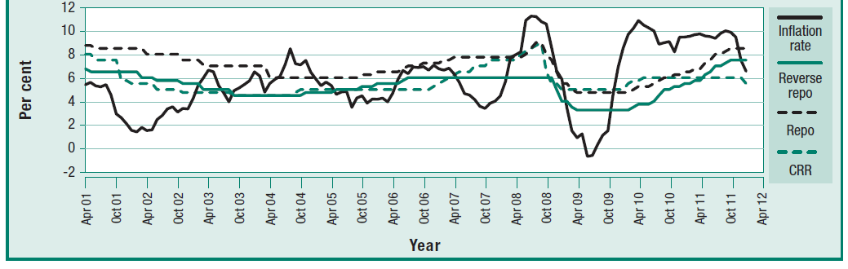
Monetary Policy Changes and Inflation
M1
M2
M3
MSS (Market Stabilization Scheme)
SMO (Special Market Operations)
CRR, SLR, Repo Rate, Reverse RR, SDR
Source: Economic Survey 2012, Govt. of India

Slide 20
What Next ?
Measuring Inflation
Inflation Cost
CPI & WPI
RBI role in regulating Inflation
Money supply side remedies
“The monetary system is crucial in determining the long-run
behavior of the price level, the inflation rate, and other
nominal variables.”….Shapiro

Slide 21
The inflation rate in India was last reported at 8.8 percent in February of 2012.
From 1969 until 2010, the average inflation rate in India was 7.99 percent reaching an historical high of 34.68 percent in September of 1974 and a record low of -11.31 percent in May of 1976. Inflation rate refers to a general rise in prices measured against a standard level of purchasing power.
The most well known measures of Inflation are the CPI which measures consumer prices, and the GDP deflator, which measures inflation in the whole of the domestic economy. This page includes: India Inflation Rate chart, historical data and news.

Slide 22
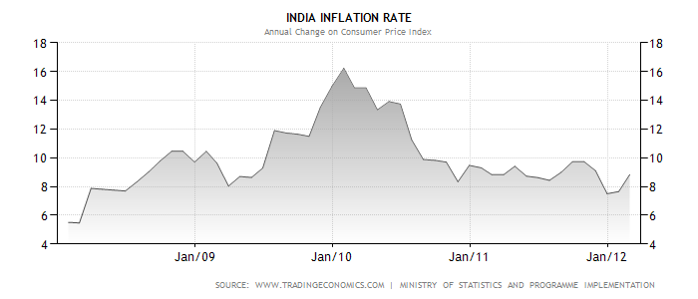

Slide 23
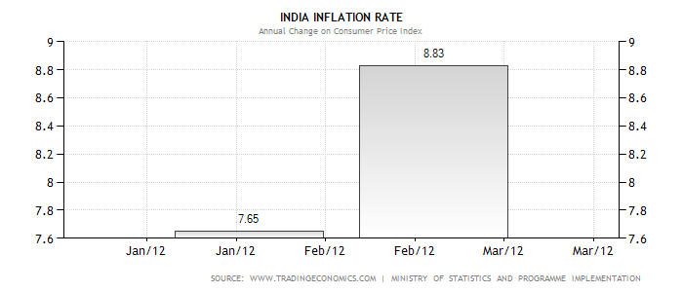

Slide 24
Case Study: Reserve Bank of India’s inflation (RBI_{i} )
“It is a mistake to look at the RBI always as a vacuum cleaner for the mess the government makes,"
Over the past two years, RBI was raising rates in a futile effort to contain stubborn inflation, as the government fumbled on fixing decrepit infrastructure and other supply bottlenecks in the economy.
Now, it has switched to pumping huge amounts of cash into the banking system to cool another government-led crisis, a funding crunch caused by heavy public borrowing to finance popular subsidies on fuel and other goods.

Slide 25
The central bank has been forced to step into this policy vacuum, announcing in quick succession two large reductions in mandatory reserve levels for banks.
The latest, last week's surprise 0.75 percentage point cut in the cash reserve ratio, was meant to ease a cash crunch in the banking system that progressively worsened over the past year as inflows into the country dried up and inflation eroded savings.
To RBI-watchers, the central bank appeared to have made a secondary goal -- ensuring the banking system is liquid and able to lend -- a priority over price stability, albeit reluctantly given worries about high oil prices.

Slide 26
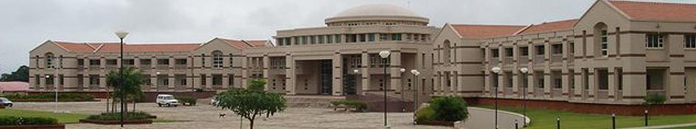
Thank you
Pupils of Economics

